Slide 1



Edtech Companies
View in Power BI

Slide 2
REVENUE MODEL
Byjus- Subscription based.
Unacademy-Paid live class, youtube, content marketing, in-app purchases.
Upgrad-B2c, recorded videos, provides Degrees with partnered universities.
Toppr-subscription based
Next Education-B2b, B2C,digitalisation of classrooms, implementation of activity-oriented education, administrative guidance and tools.
Merit Nation-Subscription and package based.
Leverage Edu- Mentorship products, end-to-end college admission guidance, programs to help them become first-job ready, and one-to-one virtual advisory for multiple career streams.
Coursera-Online courses and online degrees from leading universities and companies.
Edx-Free online classes Coursera and Udacity, edX has tested the idea of working with universities to create blended classes, in which online videos and homework are supplemented by in-class discussions. In one pilot program, San Jose State University (SJSU) blended an edX engineering course on circuits and electronics created by MIT with its own on-campus engineering class.

Slide 3
Popularity of ED-Tech companies
Byjus- More than 15 million students all over the world and has 9,00,000 paid subscribers.
Unacdemy-The learning platform is now one of India's most popular online education platforms, with over 10 million registered users and 250,000 educators.
upgrad- upGrad has a variety of courses to offer, curated with reputed universities Finance, Law, have now gained popularity.
Toppr-This edtech platform caters to over 2.5 million registered students.
Next Education- Next Education is an optimal education solutions provider, based out of Hyderabad. Touching the lives of 12,000,000+ students and 240,000+ teachers across 12,000+ schools, their solutions serve multiple purposes of both academic and administrative domains.
Merit Nation-Meritnation.com is the most popular online education platform for K-12 students across India & the Gulf. Over 7.6 million users study on Meritnation.com using Live Classes, Animated Videos, Interactive exercises, Practise Problems, Tests & more.
Coursera-Coursera is one of the top e-learning platforms and offers over 3,000 online courses, specializations, and professional certificate programs.
edx-According to Class Central's edX's 2020: Year in Review, edX's total registered learners grew to 35 million, with 110 million course enrollments by the end of 2020.

Slide 4
Marketing Strategies of different ED-Tech Companies
Byjus- Brand ambassadors like sharukh khan, regional campaigns, collaborations and sponsorship's like cricket team icc world cup, partner with news18 network, sponsorship of history tv18,Digital ads,Seo, video marketing campaigns.
Unacademy- Unacademy makes extensive use of digital marketing (Google, Social Media and OTT platforms such as Netflix, Amazon Prime, etc.), TV commercials, Radio, and out-of-home (OOH) advertising methods such as billboards.
Upgrad- The company spends a whopping sum of money on its advertisements. The company also uses online tools for marketing its products to customers. Some of the most common ones are Google Ads, Social Media Ads, promotional guest posts, and many more. UpGrad also focused on promotional activities. The company took an active part in promoting its business during the 2020 IPL season. Even in the latest IPL season, i.e. 2021 upGrad took an effective part in its promotional activities. The company tied up with Disney+ Hotstar and associated with the Star Sports network. This again became a huge boost in the company’s marketing and promotional activities.
Toppr-As part of the campaign, Toppr has launched three TVCs in collaboration with advertising and marketing communications company Lowe Lintas. These ads highlight how switching from offline coaching to Toppr’s online learning platform results in a positive change in the student’s results with a better understanding of the subject and ability to answer the questions correctly.

Slide 5
Marketing Strategies of different ED-Tech Companies
Merit Nation-The company invested heavily in UI – UX making sure that every touch point which interfaced with their users was of a high quality. The company also invested heavily in TV campaigns in the years 2010,2011 and 2012. These two factors helped the company create a perception about being a high quality brand in their space. The promise of quality helped create trust in the minds of users.Meritnation recently also came up with a mobile app that helped parents track the activities of their kids while using Meritnation product. Keeping the parents informed and involved has helped the company to become a trusted partner in the education segment.
Leverage Edu- video marketing campaigns like youtube.
Coursera-video marketing campaigns.

Slide 6
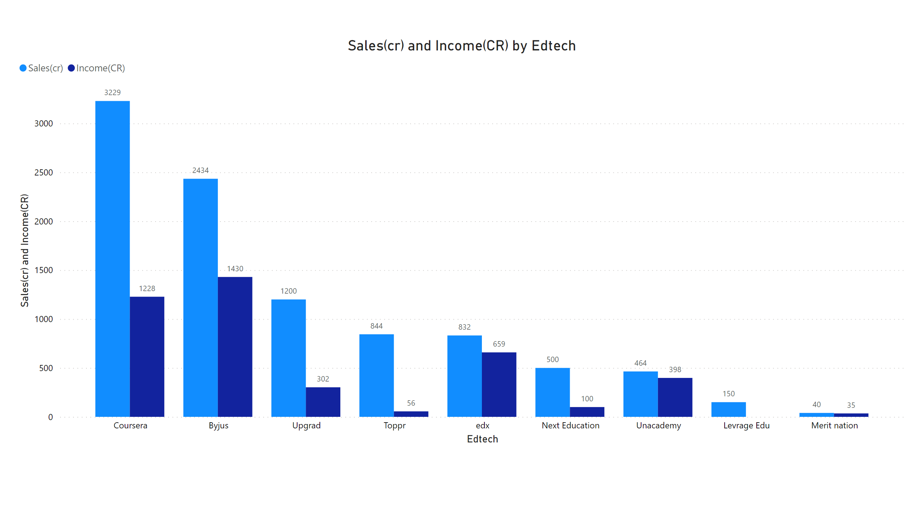
Page 2
As per the plots shows Coursera as the biggest sales with second highest income while merit nation as the lowest Sales and income.
Notes:
clusteredColumnChart
No alt text provided

Slide 7
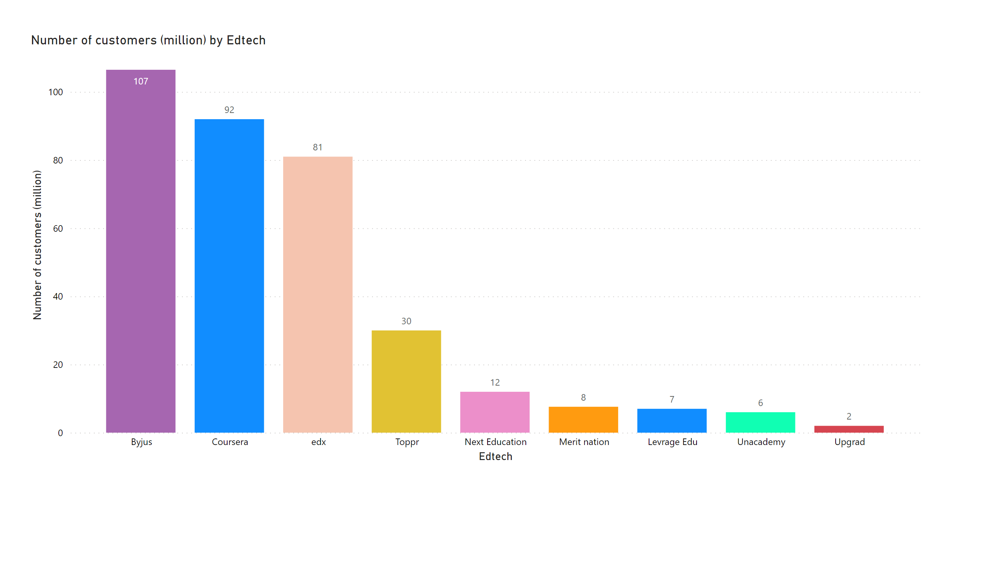
Page 3
As per the plot shows Byjus as the highest number of customers 107 million while Upgrad as the lowest of 2 million .
Notes:
columnChart
No alt text provided

Slide 8
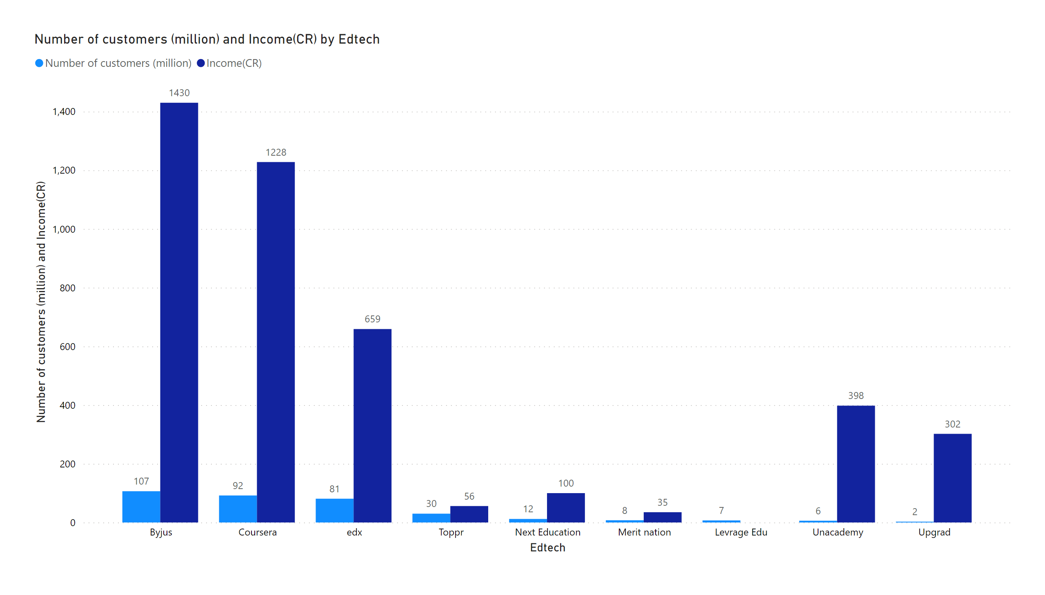
Page 4
This plot is the representation of customers(million) with compared to Income generated by companies.
Notes:
clusteredColumnChart
No alt text provided

Slide 9
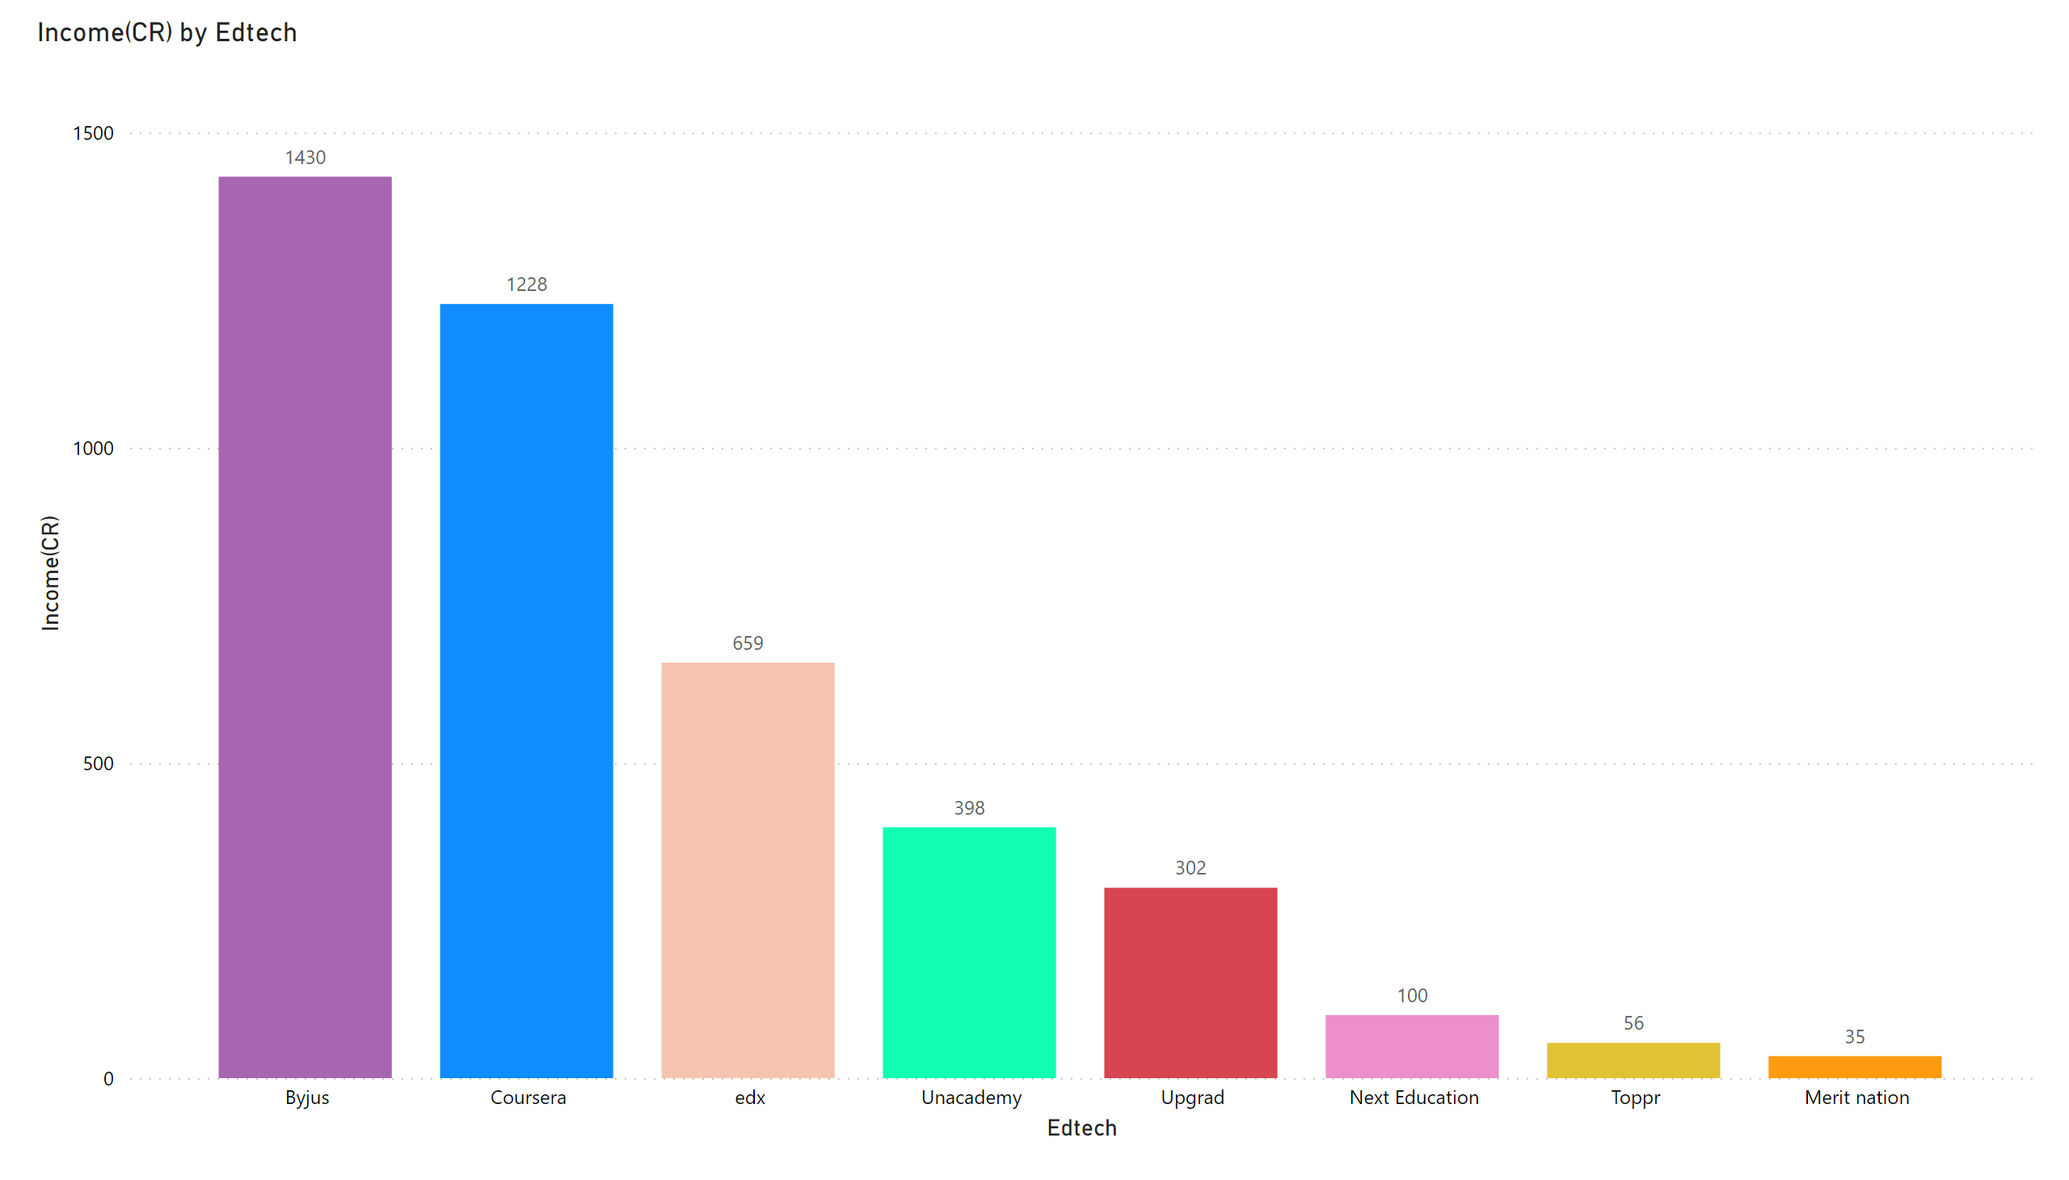
Page 5
As the plot shows Byjus has the highest net income of INR 1430cr followed by Coursera with INR 1228cr.
Merit Nation has the lowest net Income as per the plot.
Data for Leverage Edu is not revealed.
Notes:
columnChart
No alt text provided

Slide 10
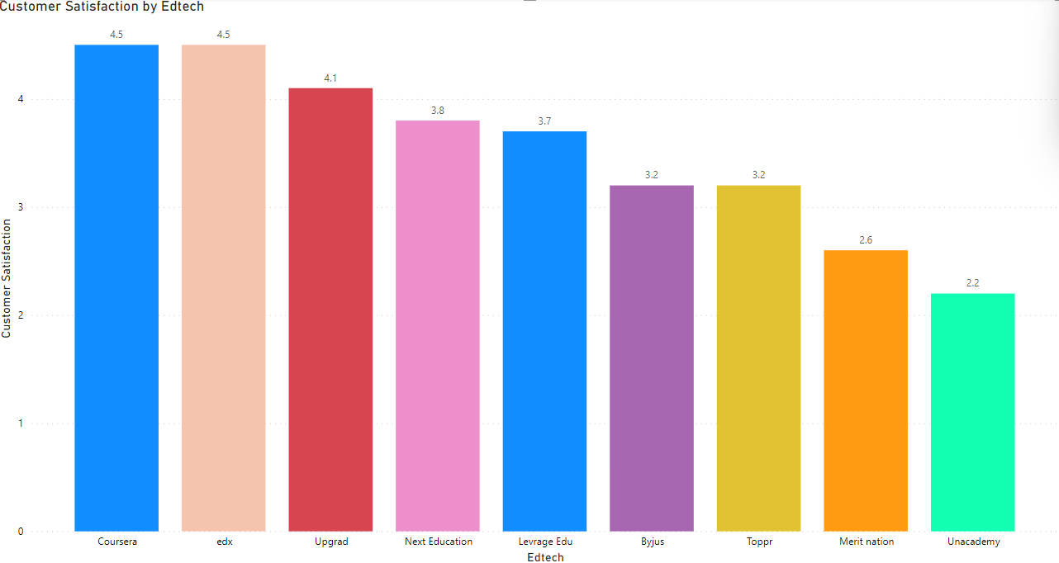
As per this plot shows Coursera as and Edx as the highest customer satisfaction stars of 4.5 while Unacademy got the lowest in this following companies of 2.2 .

Slide 11
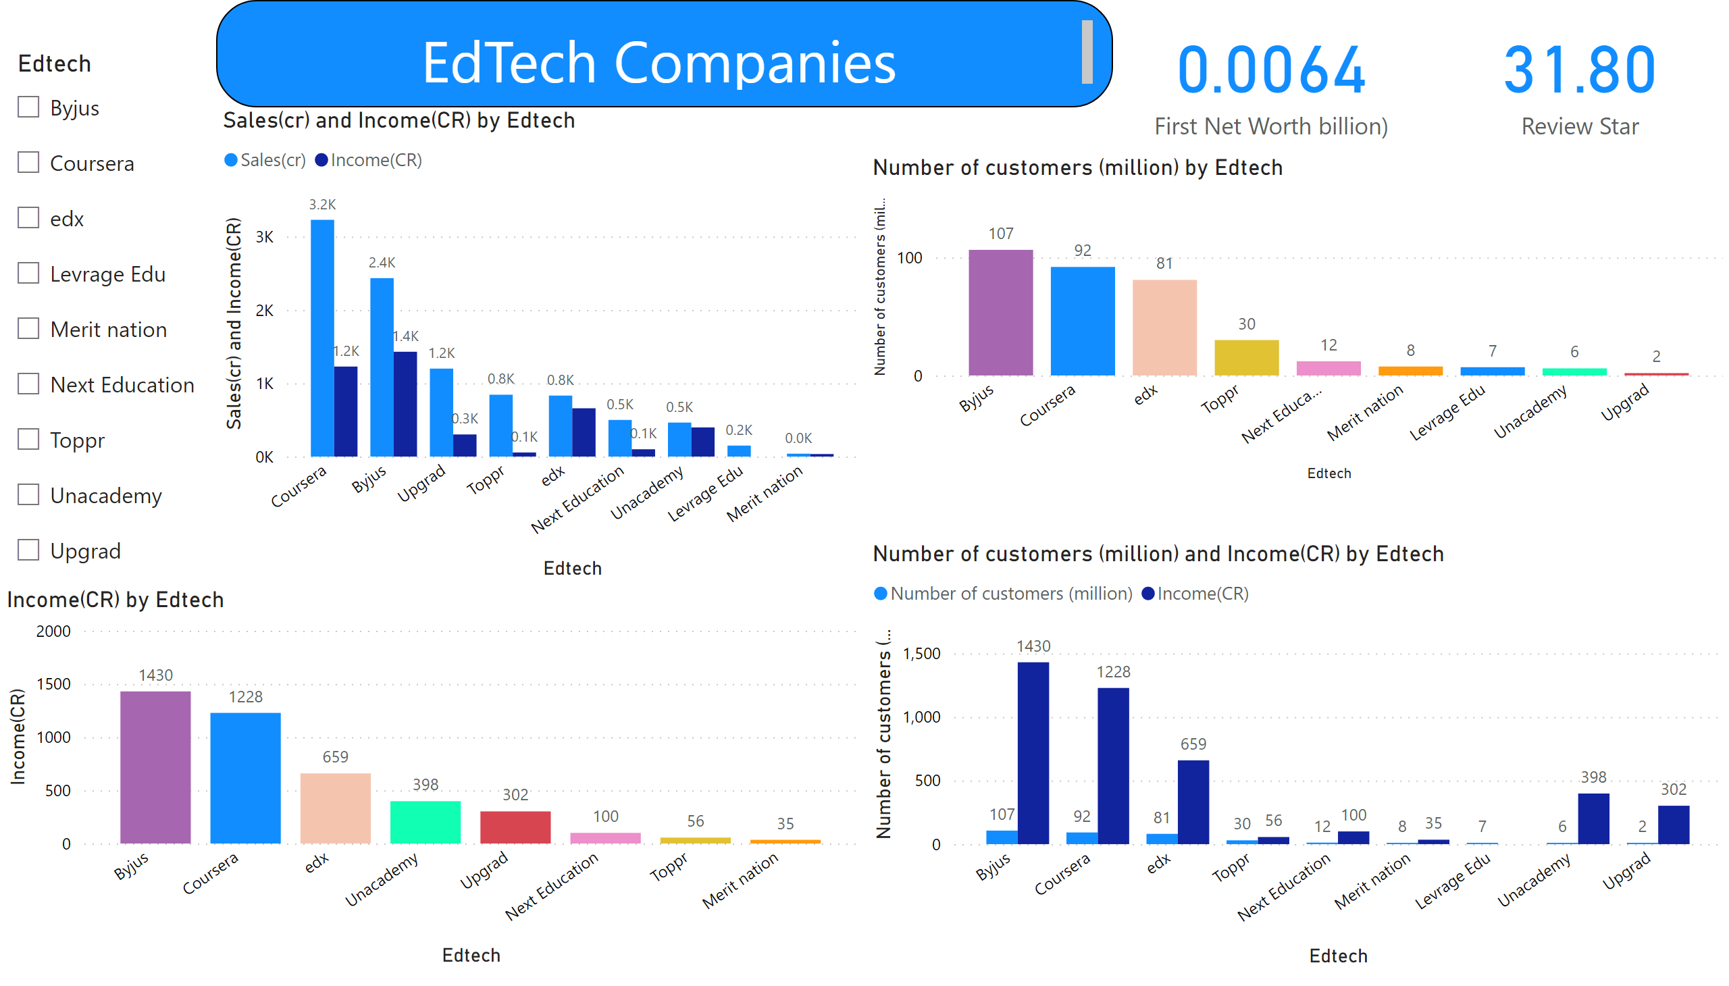
EdTech Report
Notes:
slicer
No alt text provided
card
No alt text provided
textbox
No alt text provided
columnChart
No alt text provided
columnChart
No alt text provided
clusteredColumnChart
No alt text provided
clusteredColumnChart
No alt text provided
card
No alt text provided

Slide 12
Conclusions
Revenue models-
Analysis shows that the companies with the subscription based plans are tend to have good number of users.
The concept of providing Degrees through partnered universities is also booming in the industry as an individual can get a degree online, so it could be great business module for the individual entering in this business.
Also one should focus on the great teaching faculty on the platform with great support team to help students or users to solve any query or doubts.
The idea of working with universities like MIT, Harvard to create blended classes, in which online videos and homework are supplemented by in-class discussions adds a value to the course.
programs to help them become first-job ready, and one-to-one virtual advisory for multiple career streams could also be a good revenue model to be added for business.

Slide 13
Marketing Strategies
Extensive use of Digital marketing and SEO should be used to gain large user and customer base.
If the budget of marketing allows one should promote advertisements , video marketing campaigns, youtube ads etc.
If the business is showing a good amount of growth and if the marketing budget allows, then on should also focus on collaborations and sponsorships with different digital media companies.
Ads highlight how switching from offline coaching to online learning platform results in a positive change in the student’s results with a better understanding of the subject and ability to answer the questions correctly. So this could be a great marketing strategy.

Slide 14
How Indian Ed-Tech companies can compete in international markets?
Well we can say that Indian ED-Tech companies have already started competing in the International markets. Upgrad and Great Learning which are Indian ED-Tech company's have already partnered with some foreign universities and are providing with degrees to their users.
Just like these companies other Indian ED-Tech companies should also have collaborations with the top universities in the world to have great learning experience for customers and to provide them with quality content and industry ready experience.
Well the quality of the content provided by Indian ED-Tech companies should be top notch to be able to compete in international markets are users will be joining their customer base rom all over the world.

Slide 15
THANK YOU!

